Slide 1

Meet Our
APPLIANCES WORLD
Speakers
Powering Your Home with Smart, Reliable Appliances.
01
02
03
Myra Adil
Hareem Khan
Muhammad Mubeen
Batch2512A
Batch2512A
Batch2512A
—Appliancesworld—
— Appliancesworld—
— Appliancesworld—
TOPIC
TOPIC
TOPIC
Introduction and
Purpose of the website
Products offered
Benefits of customers
What makes our website great

Slide 2

APPLIANCES WORLD
A modern home appliances website — discover, compare and order premium appliances built for everyday life.

Slide 3
Table of Contents
01
Introduction
02
Purpose of the Website
03
Products Offered
04
What makes our website great
05
Benefits for Customers
02 / 09

Slide 4
01 /// INTRODUCTION
Welcome to
Appliances World.
Appliances World is an online home appliances store designed to make buying premium appliances simple, fast and reliable. From refrigerators and washing machines to ovens, ACs and smart TVs — everything you need for a modern home lives in one place.
07
24/7
Categories
Support
03 / 09

Slide 5
02 /// PURPOSE OF THE WEBSITE
Why this website exists.
01
Discover
02
Compare
Help customers explore the full range of home appliances in one place.
Side-by-side specs, prices and reviews to choose the right product.
03
Order Online
04
Support
A simple checkout with delivery and installation across the city.
Easy access to warranty, service requests and live chat help.
04 / 09

Slide 6
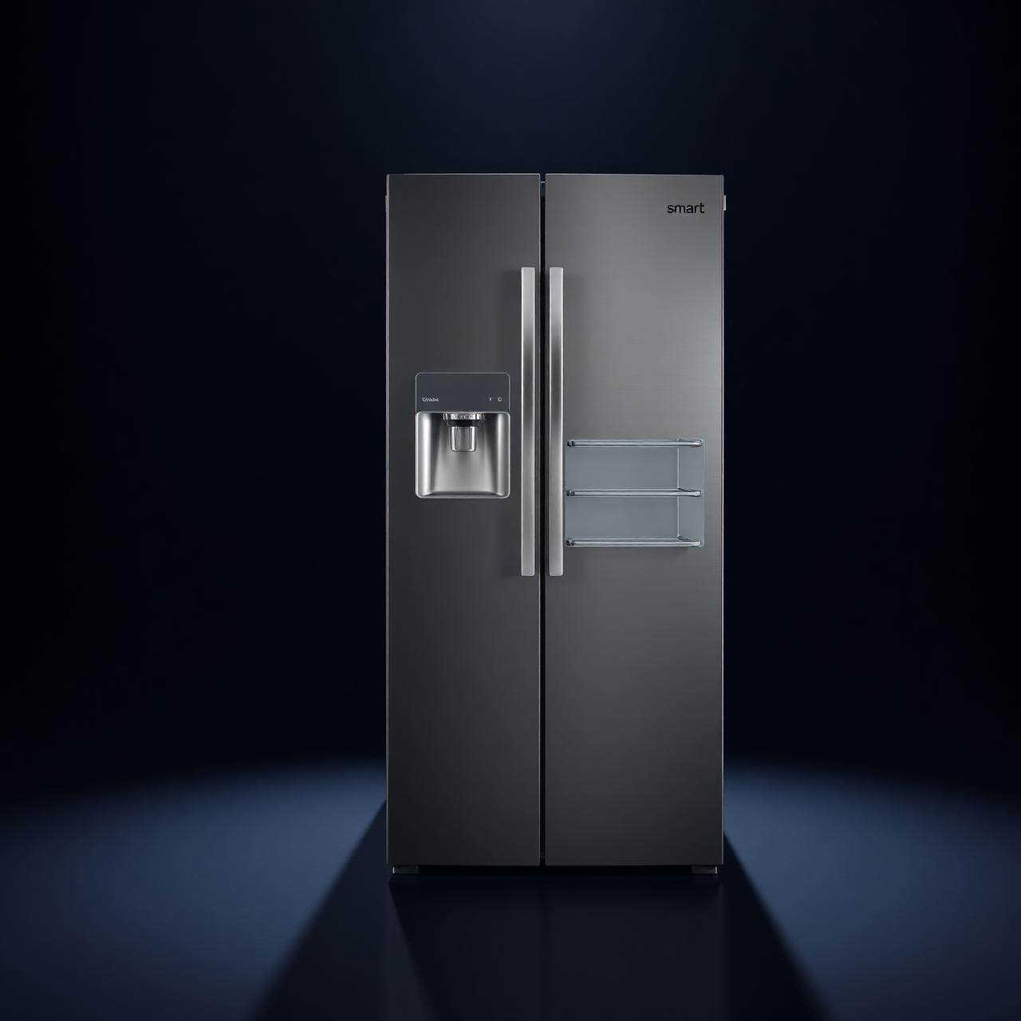
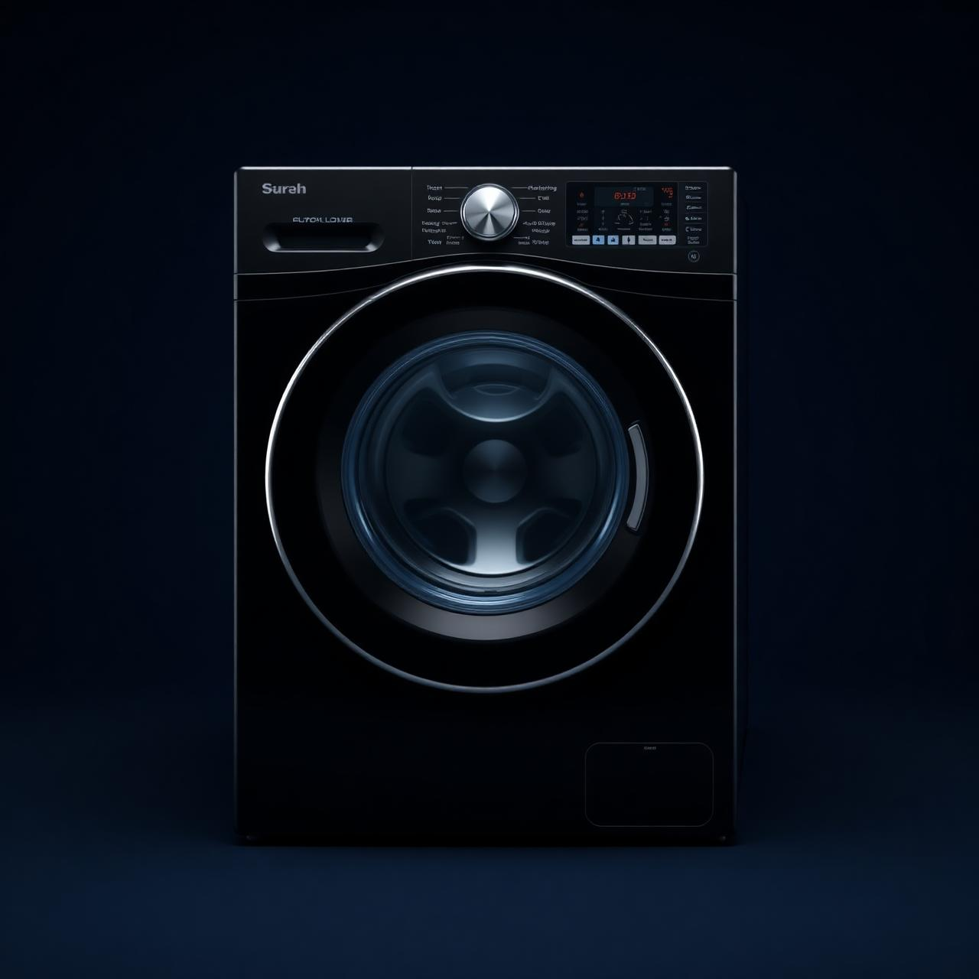
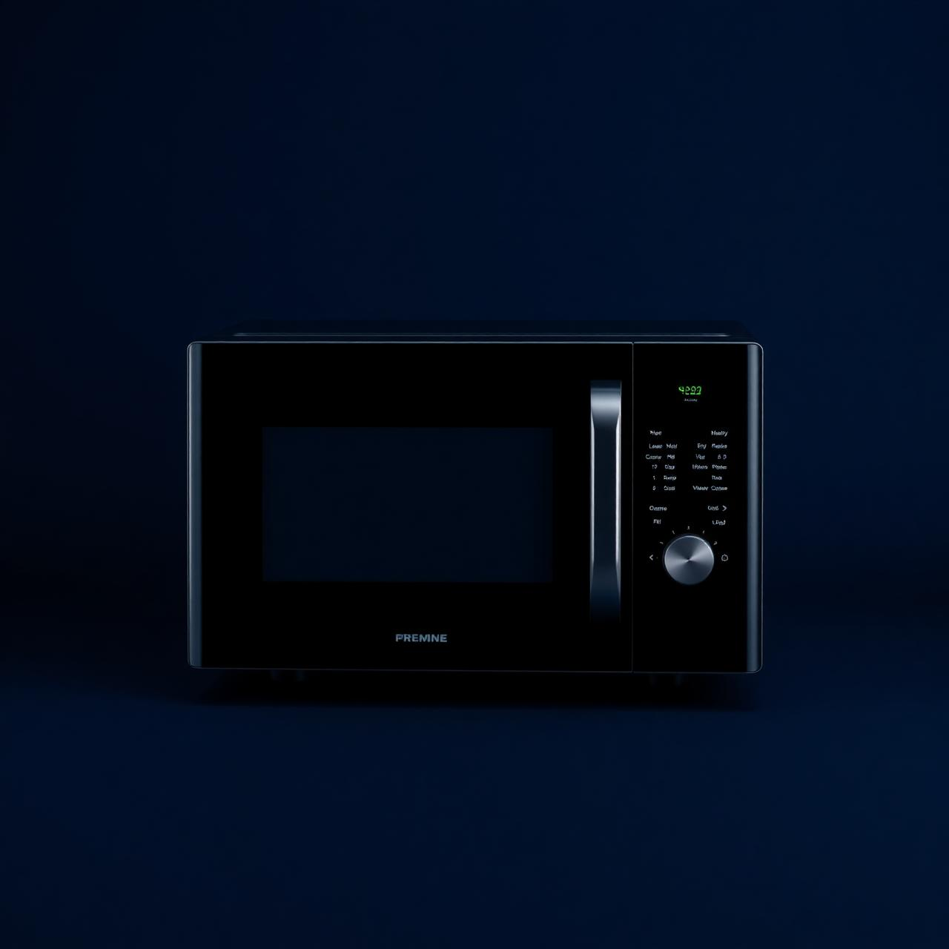


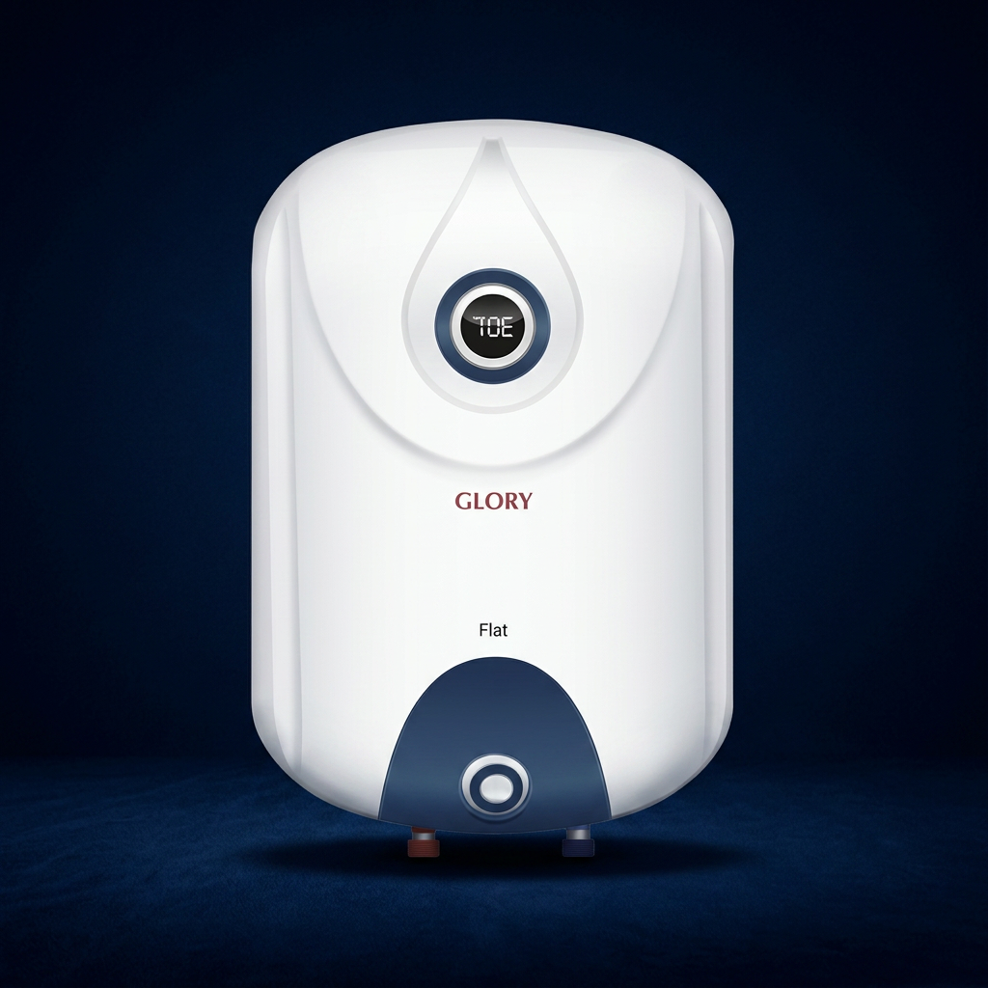
03 /// PRODUCTS OFFERED
Everything for the modern home.
Refrigerators
Washing Machines
Microwaves
Smart cooling, inverter compressors.
Steam wash and quiet spin cycles.
Convection ovens and grills.
Air Conditioners
Smart TVs
Geyser
Energy-efficient inverter ACs.
4K OLED home entertainment.
Glory Fast Geyser
05 / 09

Slide 7
04 /// KEY FEATURES
What makes our website great
Clean Product Catalog
Browse by category with high-quality images and clear specs.
Product Details
Discover a wide range of high-quality appliances with detailed product information
Responsive Design
Looks and works beautifully on mobile, tablet and desktop.
06 / 09

Slide 8
05 /// BENEFITS FOR CUSTOMERS
Built around the customer.
01
Convenience
02
Best Prices
03
Trusted Brands
Shop appliances from home, anytime — no need to visit a store.
Online-only deals, bundle discounts and seasonal offers.
Only verified products with manufacturer warranty.
04
Free Delivery
05
Expert Support
Free home delivery and installation on most orders.
Live Chat and call support from real appliances experts.
07 / 09

Slide 9
THANK YOU
09 / 09

